Slide 1



ADVANCED TECHNOLOGIES

Slide 2
THIS SESSION

Slide 3

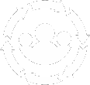














Block 1 Introduction
Progress Session
Progress Session
Progress Session
Progress Session
COMPLETION
Session
MODULE BLOCKS
Block 2 Introduction
Progress Session
Progress Session
Progress Session
Progress Session
Completion session
Block 3 Introduction
Progress Session
Progress Session
Progress Session
Progress Session
Completion session
ASSESSMENT BLOCK
Finishing workshop
Finishing workshop
PRESENTATIONS

Slide 4

BLOCK 3 TASKS
Please note specific instructions / options for each task
YOUR OWN TAKE: Each task will allow you to put your own twist – consider this carefully. What do you feel is most effective / appropriate to showcase your tech / investigation. You can use any language, any engine and any libraries you want.

Slide 5
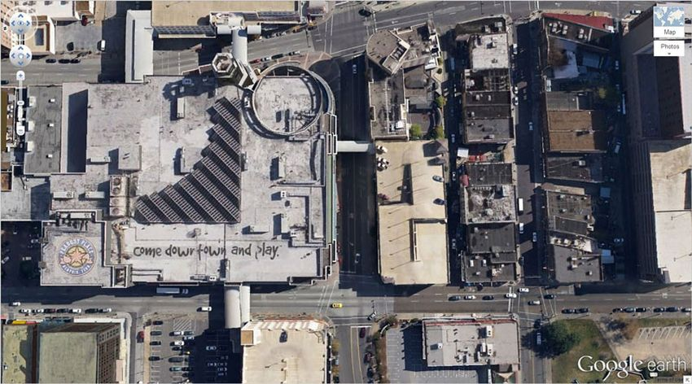
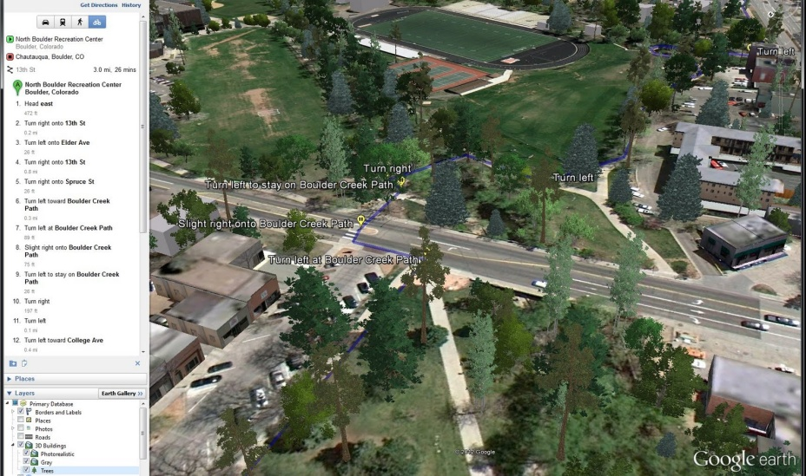
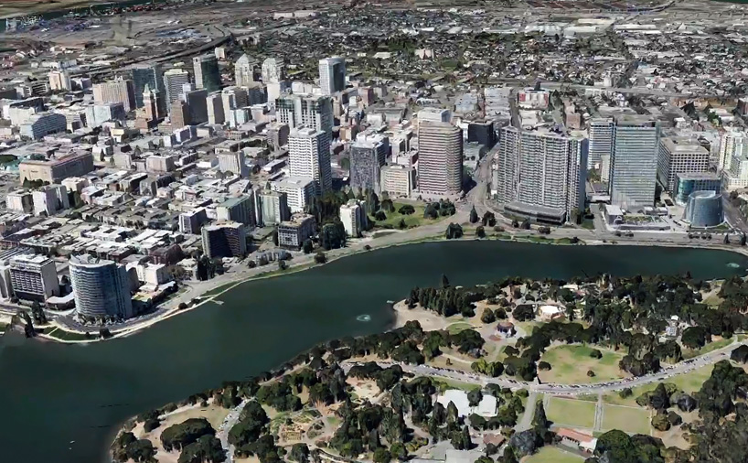

REAL LEVEL
Your task:
Imagine you could play a game set anywhere on Earth. Stop imagining and do it!
Create a tool which generates a game level from satellite imagery of the Earth. This involves image processing, (procedural) asset generation, and placement in engine.
Resource: https://digimap.edina.ac.uk/ (you have to sign in)
Use available assets or generate them based in the extracted features from the imagery
Stretch goal – Create a small game where real places are used to create the level

Slide 6
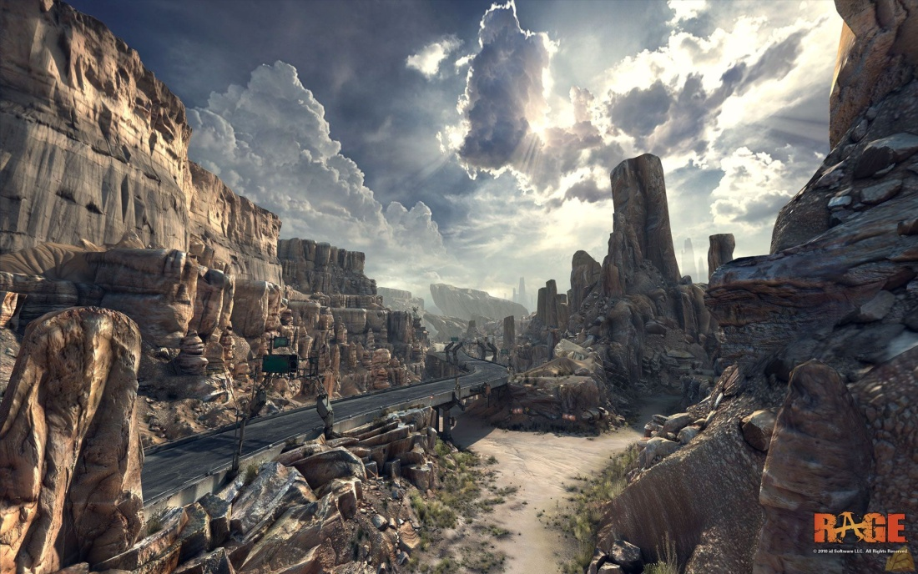
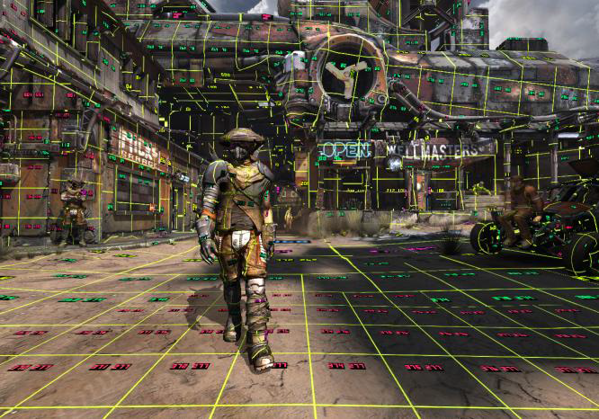
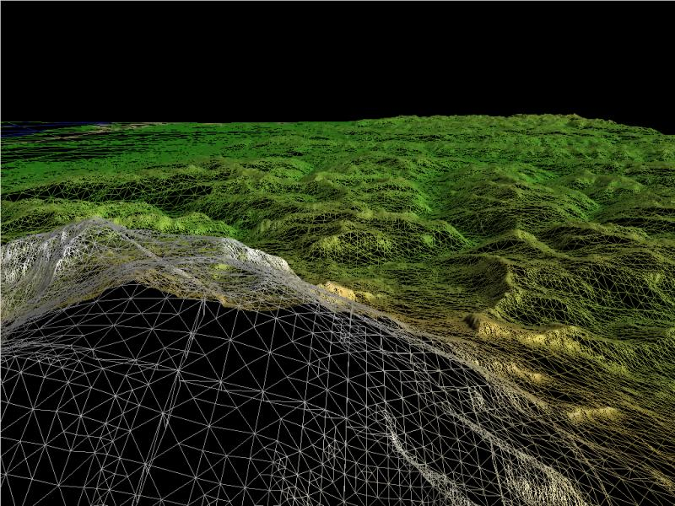
STREAMING TEXTURE/GEOMETRY
Your task:
Megatexture has been used to create games such as the new Wolfenstein games, Rage and many others, and streaming geometry is commonly used on open world games. This task is to implement the underlying technology behind open world and highly detailed games.
Research and develop an implementation of megatexture and/or a geometry streaming engine. This should progressively stream a large texture and/or geometry region stored on disk and display the areas around the player as required.
This system should also be able to modify the texture and/or geometry and store it on disk.
Stretch goal – Create tools to edit the megatexture or geometry, or combine them

Slide 7
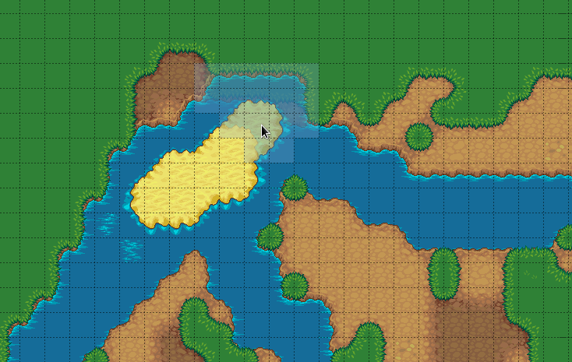
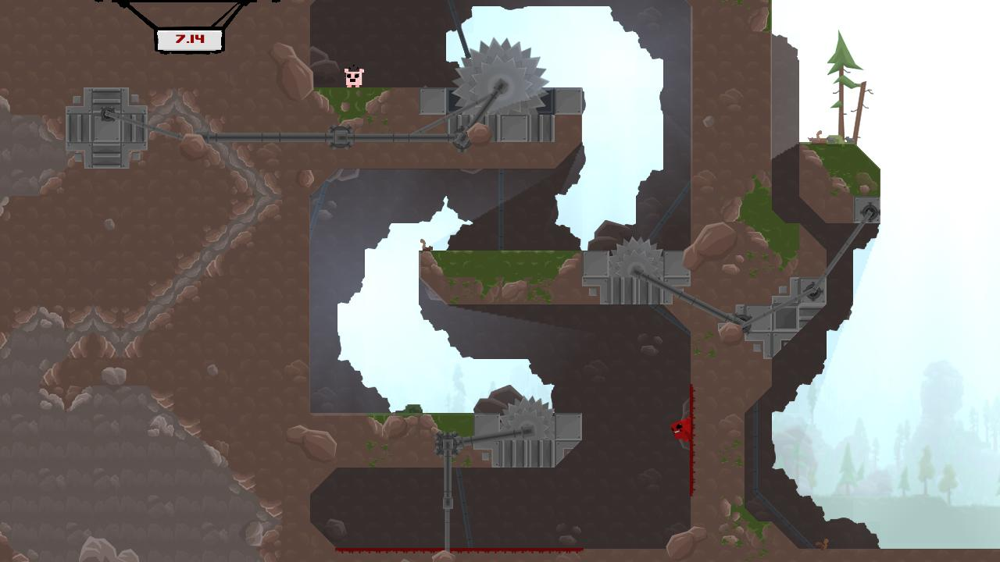
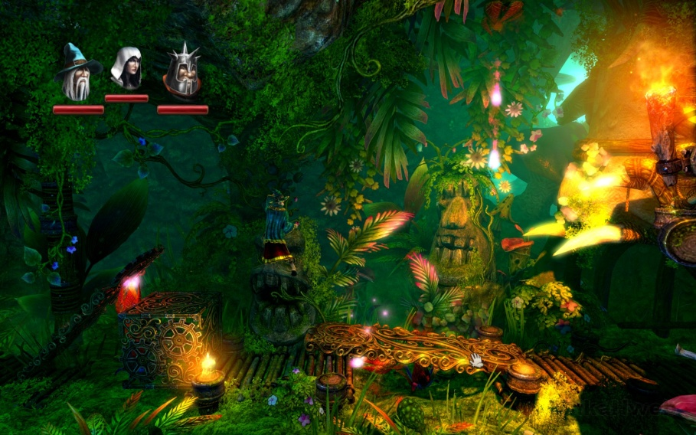
2D PROCEDURAL TILE MAP TOOL
Your task:
2D game levels still require extensive design work to design the level. Your goal is to make the designers life easier by automatically generating levels, which can also be manually edited. This should be able to save the generated level to a file in order to be used in a game.
Research and develop a tool for placing procedural levels in a 2D world to generate completeable game levels. You can use existing tilesets (with could be tileable 3D assets). The placement of these tiles should also be manually editable.
Needs to follow placement rules for corners, edges etc.
You should be able to save and load the generated level to a file
Stretch goal – Make playable levels, add runtime editing, More complicated behaviours of tiles (moving, destructible etc)
OR:
Make a tool to turn 2D levels into 3D levels (this is harder and discuss with me if you are interested)

Slide 8

ANY QUESTIONS?

